Slide 1


Lecture # 05M:
System Clock Options
Prof. Dr. Engr. Muhibul Haque Bhuyan
Professor, Department of EEE
American International University-Bangladesh (AIUB)
Dhaka, Bangladesh

Slide 2
Introduction:
Oscillating Options:
Every microcontroller needs a clock source. The CPU, the memory bus, the peripherals—clock signals are everywhere inside a microcontroller. They govern the speed at which the processor executes instructions, the baud rate of serial communication signals, the amount of time needed to perform an analog-to-digital conversion, and so much more.
All these clocking actions return to the clock signal’s source, namely the oscillator. Therefore, the oscillator must provide the desired performance from the microcontroller. Though some oscillator options are more complex or expensive than others, the choice of oscillator should reflect the importance of reducing cost and complexity whenever possible. CPU clock speed is a good indicator of the processor’s performance. In general, a higher clock speed means a faster CPU. A CPU with a clock speed of 3.2 GHz executes 3.2 billion cycles per second.

Slide 3
Introduction:
There are quite a few ways to generate a clock signal for a microcontroller. The datasheet of the microcontroller should provide a good deal of information about what types of oscillators can be used and how to implement them in a way that is compatible with its hardware. There are some advantages and disadvantages of various clock sources and thus it is needed to choose the best one among the oscillator options available for a particular microcontroller.
There are two broad types of oscillators- internal and external.
Internal
A resistor-capacitor circuit (R-C phase shift oscillator circuit)
Phase-Locked Loop (PLL) for frequency multiplication
External
CMOS clock, crystal oscillator, ceramic resonator oscillator, resistor-capacitor oscillator, capacitor-only oscillator, etc.

Slide 4
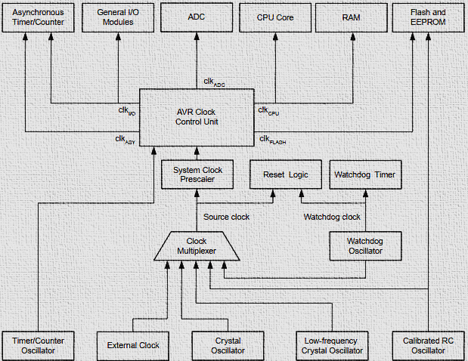
Block Diagram:
The block diagram represents the principal clock systems in the AVR and their distribution.
All the clocks need not be active at a given time.
To reduce power consumption, the clocks to modules not being used can be halted by using different sleep modes.

Slide 5
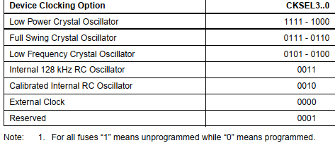
Clock Sources:
The device has the following clock source options, selectable by Flash Fuse bits as shown. The clock from the selected source is input to the AVR clock generator and routed to the appropriate modules

Slide 6
Default Clock Source:
The device is shipped with an internal RC oscillator at 8 MHz and the fuse CKDIV8 programmed, resulting in a 1 MHz system clock.
The start-up time (SUT) is set to maximum, and the time-out period is enabled (CKSEL = "0010", SUT = "10", CKDIV8 = "0"). The default setting ensures that all users can make their desired clock source setting using any available programming interface.
The term “overclocking” refers to speeding up the CPU clock for more processing power. Intel CPUs with a “K” in the name have an unlocked “multiplier” for easy overclocking when paired with a motherboard chipset that supports overclocking.
Overclocking can yield improved FPS, even for high-end CPUs like the latest Intel® Core™ i9 processor.

Slide 7
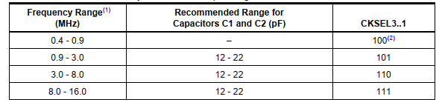
Low Power Crystal Oscillator:
Pins XTAL1 and XTAL2 are input and output respectively of an inverting amplifier, which can be configured for use as an on-chip oscillator.

Slide 8

Full-Swing Crystal Oscillator:
This crystal oscillator is a full swing oscillator, with a rail-to-rail swing on the XTAL2 output. This is useful for driving other clock inputs in a noisy environment.

Slide 9
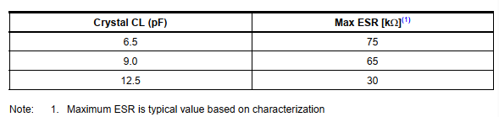
Low-Frequency Crystal Oscillator:
The low-frequency crystal oscillator is optimized for use with a 32.768 kHz watch crystal. When selecting crystals, the load capacitance and the crystal’s Equivalent Series Resistance (ESR) must be taken into consideration. Both values are specified by the crystal vendor.
ATmega48P/88P/168P/328P oscillator is optimized for very low power consumption, and thus when selecting crystals, for maximum ESR, recommended load capacitances, C_{L} are 6.5 pF, 9.0 pF, and 12.5 pF for crystals
Note: 1. This option should only be used if frequency stability at start-up is not important for the application

Slide 10

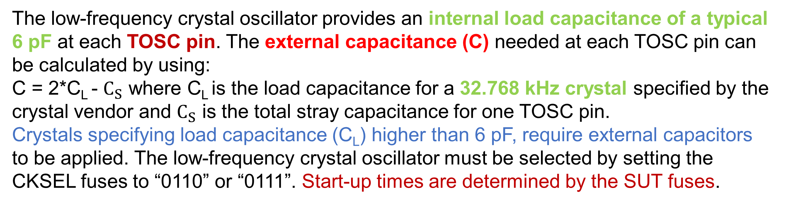
Low-Frequency Crystal Oscillator:
The low-frequency crystal oscillator provides an internal load capacitance of a typical 6 pF at each TOSC pin. The external capacitance (C) needed at each TOSC pin can be calculated by using:
C = 2*C_{L} - $C_{S}$ where C_{L} is the load capacitance for a 32.768 kHz crystal specified by the crystal vendor and $C_{S}$ is the total stray capacitance for one TOSC pin.
Crystals specifying load capacitance (C_{L}) higher than 6 pF, require external capacitors to be applied. The low-frequency crystal oscillator must be selected by setting the CKSEL fuses to “0110” or “0111”. Start-up times are determined by the SUT fuses.

Slide 11
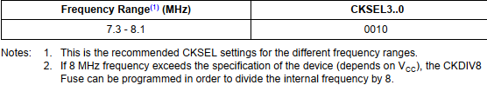
Calibrated Internal RC Oscillator:
By default, the internal RC oscillator provides an approximate 8 MHz clock. Though voltage and temperature dependent, this clock can be very accurately calibrated by the user. The device is shipped with the CKDIV8 Fuse programmed. This clock may be selected as the system clock by programming the CKSEL Fuses.
When this Oscillator is selected, start-up times are determined by the SUT Fuses.
If selected, it will operate with no external components. During reset, the hardware loads the pre-programmed calibration value into the OSCCAL Register and thereby automatically calibrates the RC oscillator.

Slide 12
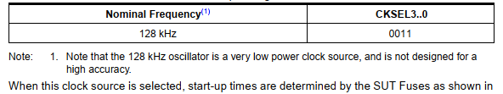
128 kHz Internal Oscillator:
The 128 kHz internal oscillator is a low-power oscillator providing a clock of 128 kHz. The frequency is nominal at 3 V and 25°C. This clock may be selected as the system clock by programming the CKSEL Fuses to “11”.
When this clock source is selected, start-up times are determined by the SUT Fuses.

Slide 13
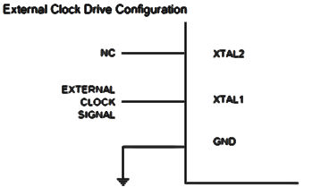

External Clock:
To drive the device from an external clock source, XTAL1 should be driven as follows-
To run the device on an external clock, the CKSEL Fuses must be programmed to “0000”

Slide 14
Timer/Counter Oscillator:
ATmega48P/88P/168P/328P uses the same crystal oscillator for the Low-frequency oscillator and Timer/Counter oscillator.
ATmega48P/88P/168P/328P share the Timer/Counter Oscillator Pins (TOSC1 and TOSC2) with XTAL1 and XTAL2 respectively.
When using the Timer/Counter Oscillator, the system clock needs to be four times the oscillator frequency. Due to this and the pin sharing, the Timer/Counter Oscillator can only be used when the calibrated internal RC oscillator is selected as the system clock source.
Applying an external clock source to TOSC1 can be done if EXTCLK in the ASSR Register is written to logic one. An external clock is selected as input instead of a 32.768 kHz watch crystal.

Slide 15
System Clock Pre-Scalar:
The ATmega48P/88P/168P/328P has a system clock Pre-scaler, and the system clock can be divided by setting the ”CLKPR – Clock Pre-scaler Register”.
This feature can be used to decrease the system clock frequency and power consumption when the requirement for processing power is low.
This can be used with all clock source options, and it will affect the clock frequency of the CPU and all synchronous peripherals.

Slide 16

Register Description:
• CLKPR-Clock Pre-scaler Register
• Bit 7 – CLKPCE: Clock Pre-scaler Change Enable
The CLKPCE bit must be written to logic one to enable the change of the CLKPS bits. The CLKPCE bit is only updated when the other bits in CLKPR are simultaneously written to zero. CLKPCE is cleared by hardware four cycles after it is written or when CLKPS bits are written. Rewriting the CLKPCE bit within this time-out period does neither extend the time-out period nor clear the CLKPCE bit.

Slide 17
Register Description:
• CLKPR-Clock Pre-scaler Register
• Bits 3..0 – CLKPS3..0: Clock Pre-scaler Select Bits 3 - 0
These bits define the division factor between the selected clock source and the internal system clock. These bits can be written run-time to vary the clock frequency to suit the application requirements. As the divider divides the master clock input to the MCU, the speed of all synchronous peripherals is reduced when a division factor is used.

Slide 18
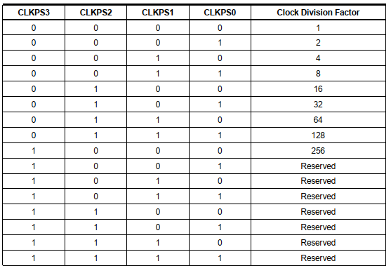
Register Description: Clock Pre-Scaler Select

Slide 19
Power Management and Sleep Modes:
Power consumption is a critical issue for a device running continuously for a long time without being turned off. So, to overcome this problem almost every controller comes with a Sleep Mode, which helps developers to design electronic gadgets. Sleep mode puts the device in power-saving mode optimal power consumption by turning off the unused modules.
An Arduino Sleep mode is also referred to as Arduino Power Save Mode or Arduino Standby Mode.
Arduino UNO, Arduino Nano, and Pro-mini come with ATmega328P and it has a Brown-Out Detector (BOD), which monitors the supply voltage at the time of Sleep Mode.

Slide 20
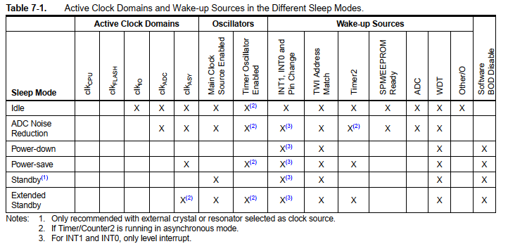
Power Management and Sleep Modes:
Sleep modes enable the application to shut down unused modules in the MCU, thereby saving power. The AVR provides various sleep modes allowing the user to tailor power consumption to the application’s requirements. There are six sleep modes in ATmega328P:

Slide 21
Power Management and Sleep Modes:

Slide 22

Register Description:
SMCR – Sleep Mode Control Register
The Sleep Mode Control Register (SMCR) contains control bits for power management. The function of these bits (SM2:0) is shown in the next slide.
For entering into any of the sleep modes, we need to enable the sleep bit in the Sleep Mode Control Register (SMCR.SE). Then, the Sleep Mode Select bits select any 1 of the sleep modes among 6 different sleep modes, viz. Idle, ADC Noise Reduction, Power-Down, Power-Save, Standby, and External Standby.
An internal or external Arduino interrupt or a Reset can wake up the Arduino from sleep mode.

Slide 23
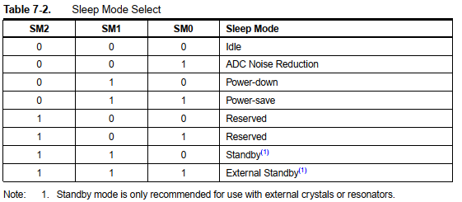
Register Description:
Setting up SMCR using Assembly Language:
0b00000111 =0x07
LDI R1, 0x07;
OUT SMCR, R1;

Slide 24
Idle Mode:
For entering into the Idle sleep mode, write the SM[2,0] bits of the controller ‘000’. This mode stops the CPU but allows the SPI, 2-wire serial interface, USART, Watchdog, counters, and analog comparator to operate.
Idle mode stops the CLKCPU and CLKFLASH.
Arduino can be woken up at any time by using external or internal interrupts. Arduino Code for Idle Sleep Mode:
LowPower.idle(SLEEP_8S, ADC_OFF, TIMER2_OFF, TIMER1_OFF, TIMER0_OFF, SPI_OFF, USART0_OFF, TWI_OFF);
The Arduino cannot sleep for a specific time, but we have the following timers:
SLEEP_15MS, SLEEP_30MS, SLEEP_60MS, SLEEP_120MS, SLEEP_250MS, SLEEP_500MS, SLEEP_1S, SLEEP_2S, SLEEP_4S, SLEEP_8S, SLEEP_FOREVER

Slide 25
ADC Noise Reduction Mode:
To use this sleep mode, write the SM[2,0] bit to ‘001’. The mode stops the CPU but allows the ADC, external interrupt, USART, 2-wire serial interface, Watchdog, and counters to operate. ADC Noise Reduction mode basically stops the CLKCPU, CLKI/O, and CLKFLASH. We can wake up the controller from the ADC Noise Reduction mode by the following methods:
External Reset
Watchdog System Reset
Watchdog Interrupt
Brown-out Reset
2-wire Serial Interface address match
External level interrupt on INT
Pin change interrupt
Timer/Counter interrupt
SPM/EEPROM ready interrupt

Slide 26
Power-Down Mode:
Power-Down Mode stops all the generated clocks and allows only the operation of asynchronous modules. It can be enabled by writing the SM[2,0] bits to ‘010’. In this mode, the external oscillator turns OFF, but the 2-wire serial interface, watchdog, and external interrupt continue to operate. It can be disabled by only one of the methods below:
External Reset
Watchdog System Reset
Watchdog Interrupt
Brown-out Reset
2-wire Serial Interface address match
External level interrupt on INT
Pin change interrupt

Slide 27
Standard Low Power Example:
This is the simplest way of implementing the Low Power mode. It will use the LED as an indicator to tell if the device is in an active state or sleep state. The device will be in a sleep state for 5 seconds.
#include "ArduinoLowPower.h"
void setup() {
pinMode(LED_BUILTIN, OUTPUT); }
void loop() {
digitalWrite(LED_BUILTIN, HIGH);
delay(1000);
digitalWrite(LED_BUILTIN, LOW);
delay(1000);
LowPower.sleep(5000); // Not for Arduino Uno, Nano, Mega, etc. boards.
}
Here we can also change a line of the code to perform the Deep Sleep mode of the device.
//LowPower.sleep(5000);
LowPower.deepSleep(5000);

Slide 28
Low Power-Power Down Mode Example:
In this sketch, the Arduino blinks an LED for 2 s and is then powered down for 2 s, and during that time, the ADC and Brown-Out Detect (BOD) are disabled. When powered down, the Arduino's current drops from 14 mA, down to just 6 μA!
#include "LowPower.h"
void setup() {
pinMode(13,OUTPUT);
}
void loop() {
digitalWrite(13,HIGH);
delay(2000);
digitalWrite(13,LOW);
LowPower.powerDown(SLEEP_2S, ADC_OFF, BOD_OFF);
}
Let’s load this sketch onto our Arduino, which is running with a 5 V supply at 16 MHz. To see how little current is needed in sleep mode, we are using an Arduino ATmega328P board to minimize the current.
If you want longer sleep durations, you can chain multiple 8-second sleeps, since 8 seconds is the watchdog timer’s maximum.
for (int i = 0; i < 5; i++) {
LowPower.powerDown(SLEEP_8S, ADC_OFF, BOD_OFF); // Sleep for ~40s total
}

Slide 29
Arduino Code for Power-Down Periodic Mode:
LowPower.powerDown(SLEEP_8S, ADC_OFF, BOD_OFF);
The code is used to turn on the power-down mode. By using the above code, the Arduino will go to sleep for eight seconds and wake up automatically.
We can also use the power-down mode with an interrupt, where the Arduino will go to sleep but only wakes up when an external or internal interrupt is provided.
Arduino Code for Power-Down Interrupt Mode:
void loop() {
// Allow the wake-up pin to trigger an interrupt on low.
attachInterrupt(0, wakeUp, LOW);
LowPower.powerDown(SLEEP_FOREVER, ADC_OFF, BOD_OFF);
// Disable external pin interrupt on the wake-up pin.
detachInterrupt(0);
// Do something here
}

Slide 30
Power-Save Mode: To enter the power-save mode, we need to write the SM[2,0] pin to ‘011’. This sleep mode is like the power-down mode, only with one exception, i.e., if the timer/counter is enabled, it will remain running even at the time of sleep. The device can be woken up by using the timer overflow bit, TOVn.
If you are not using the time/counter, it is recommended to use Power-Down mode instead of Power-Save mode.
Standby Mode: The standby mode is identical to the Power-Down mode; the only difference between them is that the external oscillator keeps running in this mode. For enabling this mode, write the SM[2,0] pin to ‘110’.
Extended Standby Mode: This mode is like the power-save mode, only with one exception that the oscillator is kept running. The device will enter the Extended Standby mode when we write the SM[2,0] pin to ‘111’. The device will take six clock cycles to wake up from the extended standby mode.

Slide 31
Arduino Codes for Low Power Modes:
#include "LowPower.h"
void ledBlink(){
digitalWrite(LED_BUILTIN, HIGH);
delay(500);
digitalWrite(LED_BUILTIN, LOW);
}
void setup(){
pinMode(LED_BUILTIN, OUTPUT);
}
void loop(){
ledBlink();
LowPower.powerStandby(SLEEP_4S, ADC_OFF, BOD_ON);
}
#include "LowPower.h"
void ledBlink(){
digitalWrite(LED_BUILTIN, HIGH);
delay(500);
digitalWrite(LED_BUILTIN, LOW);
}
void setup(){
pinMode(LED_BUILTIN, OUTPUT);
}
void loop(){
ledBlink();
LowPower.powerExtStandby(SLEEP_4S, ADC_OFF, BOD_ON, TIMER2_OFF);
}
#include "LowPower.h"
void ledBlink(){
digitalWrite(LED_BUILTIN, HIGH);
delay(500);
digitalWrite(LED_BUILTIN, LOW);
}
void setup(){
pinMode(LED_BUILTIN, OUTPUT);
}
void loop(){
ledBlink();
LowPower.adcNoiseReduction(SLEEP_2S, ADC_OFF, TIMER2_OFF);
}

Slide 32
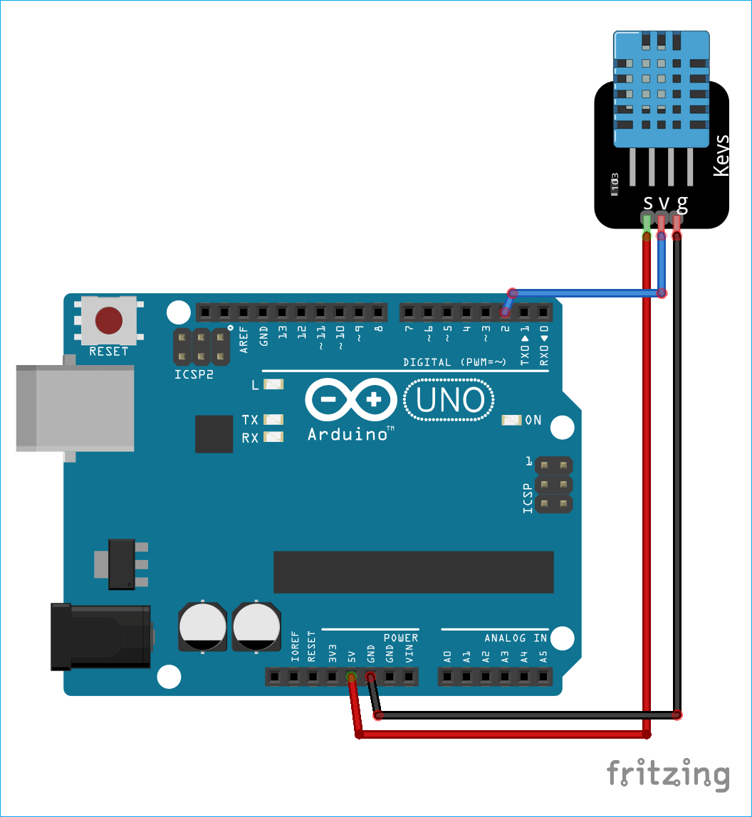
Practical Application with a DHT11 Sensor:
Below are the requirements for this project, after connecting the circuit as per the circuit diagram. Upload the sleep mode code into Arduino using Arduino IDE. Arduino will enter idle sleep mode. Then check the current consumption into the USB meter. Otherwise, you can also use a clamp meter for the same.
DHT11 Sensor
In this setup, to demonstrate Arduino Deep sleep modes, the Arduino is plugged into the USB meter. Then the USB meter is plugged into the USB port of the laptop.
The data pin of the DHT11 sensor is attached to the D2 pin of the Arduino.

Slide 33
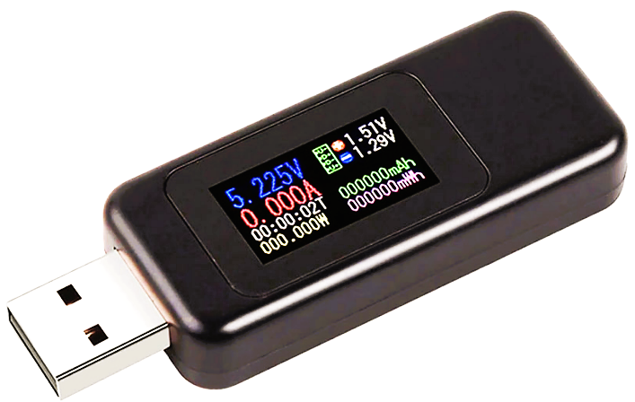
Code Explanation
The code starts by including the library for the DHT11 sensor and the Low Power library. For downloading the Low Power library follow the link (https://github.com/rocketscream/Low-Power).
Then we defined the Arduino pin number to which the data pin of the DHT11 is connected and created a DHT object.
#include <dht.h>
#include <LowPower.h>
#define dataPin 2
dht DHT;
USB Meter

Slide 34
Code Explanation
In the void setup function, we have initiated the serial communication by using Serial.begin(9600), here the 9600 is the baud rate. We are using Arduino’s built-in LED as an indicator for the sleep mode. So, we have set the pin as OUTPUT and sent a LOW signal to this pin using the digitalWrite() command.
void setup() {
Serial.begin(9600);
pinMode(LED_BUILTIN, OUTPUT);
digitalWrite(LED_BUILTIN, LOW);
}

Slide 35
Code Explanation
In the void loop function, we are making the built-in LED HIGH and the reading the temperature and humidity data from the sensor. Here, DHT.read11(); command is reading the data from the sensor. Once data is calculated, we can check the values by saving them into any variable. Here, we have taken two float type variables ‘t’ and ‘h’. Hence, the temperature and humidity data is printed serially on the serial monitor.
void loop() {
Serial.println("Get Data From DHT11");
delay(1000);
digitalWrite(LED_BUILTIN, HIGH);
int readData = DHT.read11(dataPin); // DHT11

Slide 36
Code Explanation
float t = DHT.temperature;
float h = DHT.humidity;
Serial.print("Temperature = ");
Serial.print(t);
Serial.print(" C | ");
Serial.print("Humidity = ");
Serial.print(h);
Serial.println(" % ");
delay(2000);

Slide 37
Code Explanation
Before enabling the sleep mode, we are printing "Arduino:- I am going for a Nap" and making the built-in LED LOW. After that, Arduino sleep mode is enabled by using the command mentioned below in the code.
The below code enables the idle periodic sleep mode of the Arduino and gives a sleep of eight seconds. It turns the ADC, Timers, SPI, USART, and 2-wire interface into the OFF condition.
Then, it automatically wakes up Arduino from sleep after 8 seconds and prints “Arduino:- Hey I just Woke up”.

Slide 38
Code Explanation
Serial.println("Arduino:- I am going for a Nap");
delay(1000);
digitalWrite(LED_BUILTIN,LOW);
LowPower.idle(SLEEP_8S, ADC_OFF, TIMER2_OFF, TIMER1_OFF, TIMER0_OFF,
SPI_OFF, USART0_OFF, TWI_OFF);
Serial.println("Arduino:- Hey I just Woke up");
Serial.println("");
delay(2000);
}
So, using this code, Arduino will only wake up for 24 (6×4 times of the loop) seconds in a minute and will remain in sleep mode for the rest of the 36 (= 60 – 24) seconds, which significantly reduces the power consumed by the Arduino weather station. Therefore, using the Arduino with the sleep mode can approximately double the device runtime.

Slide 39
Experimental Setup with USB Meter
USB meter is a plug-and-play device used to measure the voltage and current from any USB port. The dongle plugs in between the USB power supply (computer USB port) and the USB device (Arduino). This device has a 0.05 Ω resistor in-line with the power pin through which it measures the value of the current drawn. The device comes with four seven-segment displays, which instantly display the values of current and voltage consumed by the attached device. These values flip in an interval of every 3 seconds.

Slide 40
Example 1
Compute the total time for which the device is in low-power power-save mode as per the following program if the loop continues for 20 cycles.
#include "LowPower.h"
void ledBlink(){
digitalWrite(LED_BUILTIN, HIGH);
delay(500);
digitalWrite(LED_BUILTIN, LOW); }
void setup(){
pinMode(LED_BUILTIN, OUTPUT);
}
void loop(){
ledBlink();
LowPower.powerSave(SLEEP_4S, ADC_OFF, BOD_ON, TIMER2_OFF);
}
Answer:
If the above program is run, then the time for which the device is in low-power deep sleep mode is 4 s. Hence, if the loop continues for 20 cycles, then the device is in low-power deep sleep mode for 4×20 = 80 s.

Slide 41
Example 2
Determine the output of the following program. Compute the duration of Arduino blinks an LED and makes the system power down. When powered down, the Arduino’s current drops from 10 mA to just 8 μA. The supply voltage is 3.3 V. Compute the amount of power that is saved by the Arduino during this power-down mode.
#include "LowPower.h"
void setup() {
pinMode(10, OUTPUT); }
void loop() {
digitalWrite(10, HIGH);
delay(1000);
digitalWrite(10, LOW);
LowPower.powerDown(SLEEP_4S, WDT_OFF, BOD_OFF, SPI_OFF, TWI_OFF);
}
Solution:
If the above program is run, then the time for which the LED is ON is 1000 ms or 1 s because the digitalWrite() function sends a ‘HIGH’ signal to pin 10, where an LED is connected, and then the delay() function makes a delay of 1000 ms. After that, the digitalWrite() function sends a ‘LOW’ signal to pin 10. After that, there is no delay() function, but the device goes into power-down mode for 4 s. As such, the duration that the Arduino blinks an LED connected to pin 10 is every 5 s, that is, the LED is ON for 1 s and OFF for 4 s, and this loop continues.
Initially, when the power is not down then the device draws a 10 mA current. Hence, it consumes a power of 3.3×10 = 33 mW.
When the device is in low-power power-down mode, then the device draws an 8 μA current. Hence, it consumes a power of 3.3×8 = 26.4 μW = 0.0264 mW.
So, the amount of power that is saved by the Arduino during the low-power power-down mode = 33 – 0.0264 = 32.9736 mW.

Slide 42
Example 3
Determine the output of the following program. Compute power and energy consumption during the ON and OFF conditions as well as SLEEP modes in idle and power down states. Compute power savings.
#include “LowPower.h”
void loop() {
pinMode(3, OUTPUT); }
void setup() {
digitalWrite(3, HIGH);
delay(4000); // USB Meter readings = 4.971 V, 0.758 A)
digitalWrite(3, LOW);
delay(2000); // USB Meter readings = 5.017 V, 0.125 A)
LowPower.idle(SLEEP_8S, ADC_OFF, SPI_OFF); // USB Meter readings = 5.15 V, 0.001 A)
LowPower.powerDown(SLEEP2S, WDT_OFF, BOD_OFF); // USB Meter readings = 5.08 V, 0.005 A) }
Solution:
If the above program is run then the time for which the LED is ON is 4000 ms or 4 s because the digitalWrite() function sends a ‘HIGH’ signal to pin 3 where an LED is connected and then the delay() function makes a delay of 4000 ms. After that, the digitalWrite() function sends a ‘LOW’ signal to pin 3. After that, there is a delay() function, so the LED is turned OFF for 2000 ms or 2 s. Then the device goes into idle mode for 8 s. Finally, the device goes into power-down mode for 2 s. As such, the duration that the Arduino blinks an LED connected to pin 3 is every 16 s, that is, the LED is ON for 4 s and OFF for 2 + 8 + 2 = 12 s, and this loop continues.

Slide 43
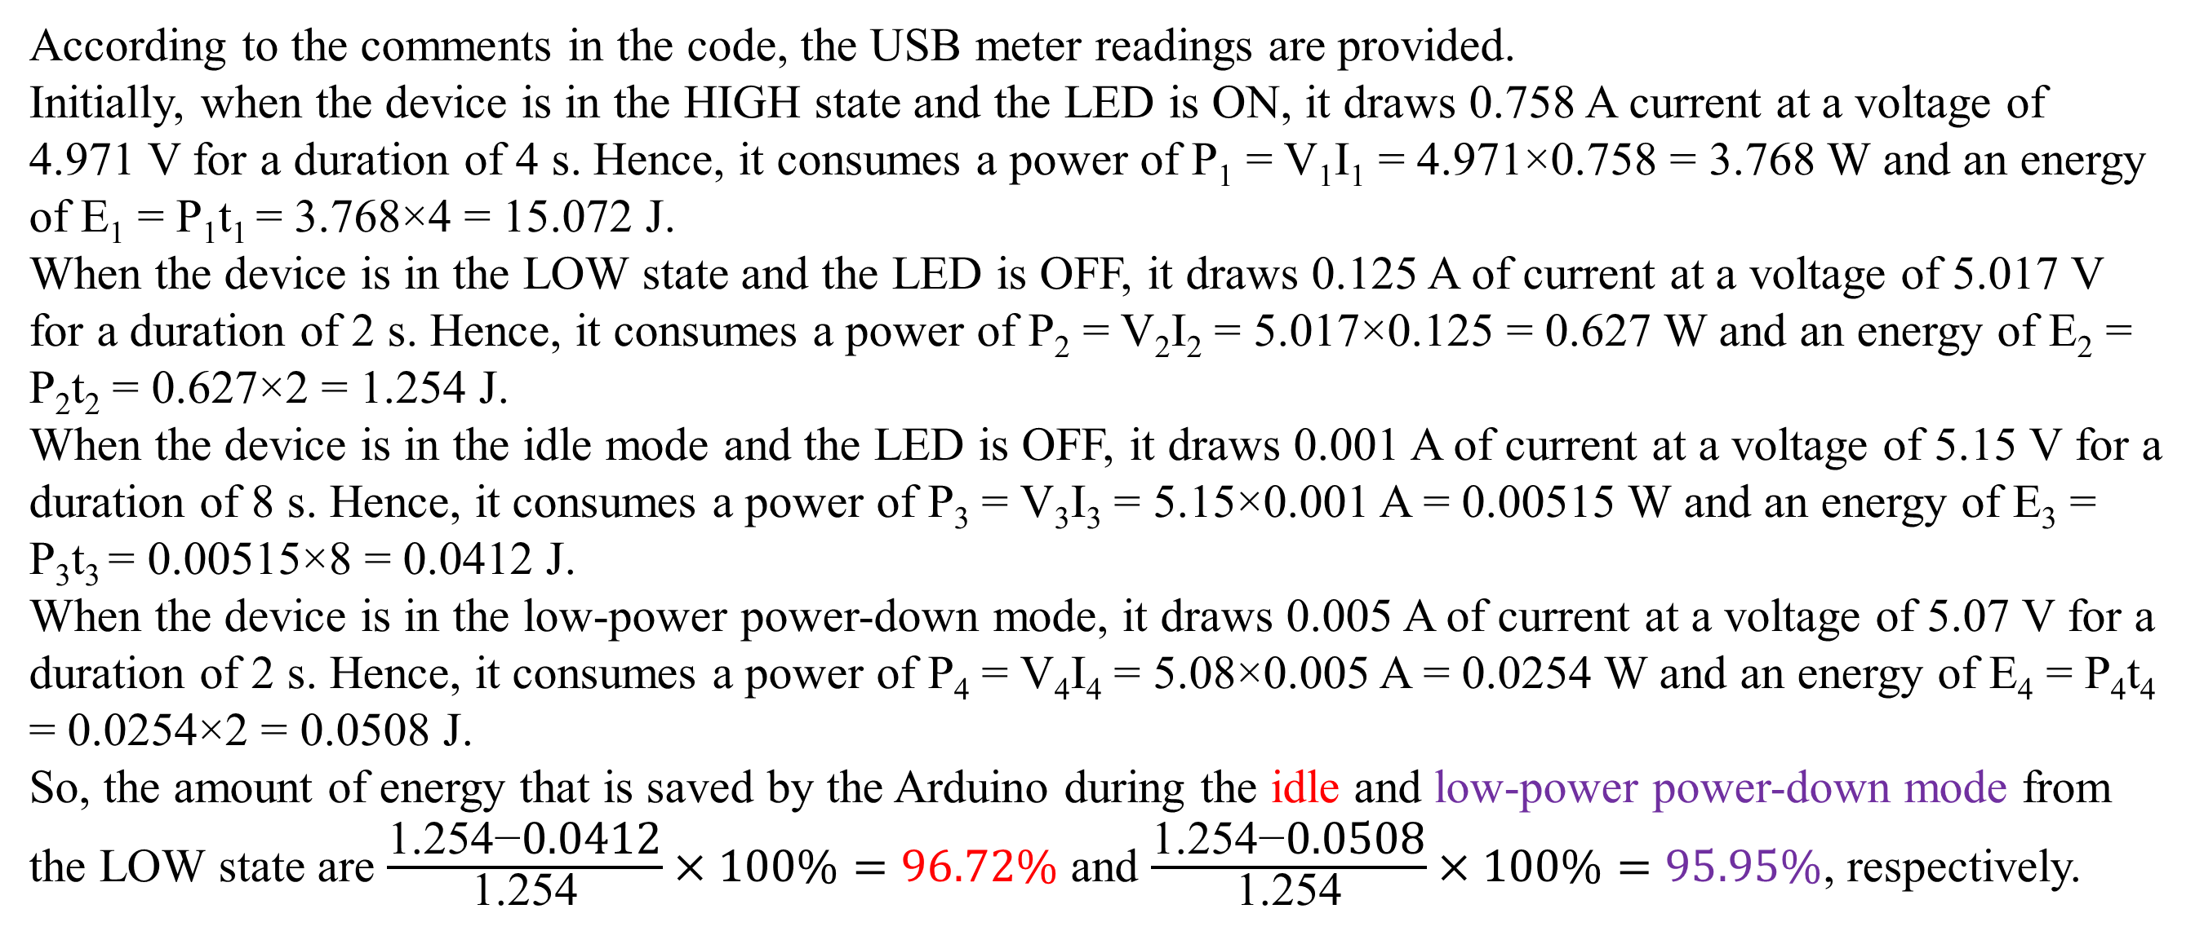
Example 3
According to the comments in the code, the USB meter readings are provided.
Initially, when the device is in the HIGH state and the LED is ON, it draws 0.758 A current at a voltage of 4.971 V for a duration of 4 s. Hence, it consumes a power of P₁ = V₁I₁ = 4.971×0.758 = 3.768 W and an energy of E₁ = P₁t₁ = 3.768×4 = 15.072 J.
When the device is in the LOW state and the LED is OFF, it draws 0.125 A of current at a voltage of 5.017 V for a duration of 2 s. Hence, it consumes a power of P₂ = V₂I₂ = 5.017×0.125 = 0.627 W and an energy of E₂ = P₂t₂ = 0.627×2 = 1.254 J.
When the device is in the idle mode and the LED is OFF, it draws 0.001 A of current at a voltage of 5.15 V for a duration of 8 s. Hence, it consumes a power of P₃ = V₃I₃ = 5.15×0.001 A = 0.00515 W and an energy of E₃ = P₃t₃ = 0.00515×8 = 0.0412 J.
When the device is in the low-power power-down mode, it draws 0.005 A of current at a voltage of 5.07 V for a duration of 2 s. Hence, it consumes a power of P₄ = V₄I₄ = 5.08×0.005 A = 0.0254 W and an energy of E₄ = P₄t₄ = 0.0254×2 = 0.0508 J.
So, the amount of energy that is saved by the Arduino during the idle and low-power power-down mode from the LOW state are $\frac{\text{1.254−}\text{0.}\text{0412}}{\text{1.254}}×100\%=96.72\%$ and $\frac{\text{1.254}\text{−}\text{0.0508}}{\text{1.254}}×100\%=95.95\%$, respectively.

Slide 44
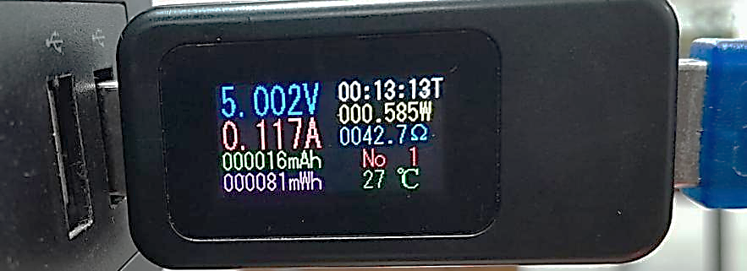
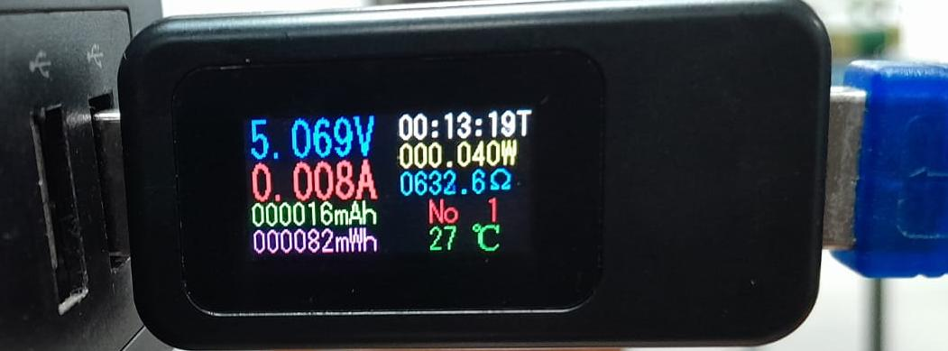
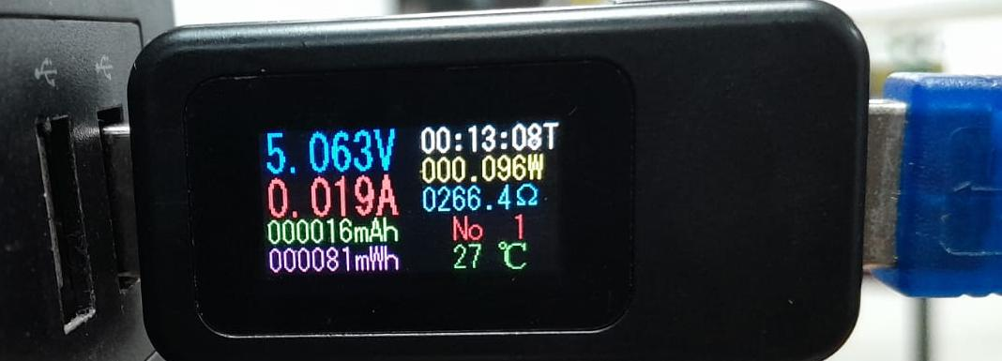
Example 4
Compute power and energy consumption during the ON, OFF, and SLEEP modes, according to the following USB meter readings. Compute the percentage of power and energy savings for the OFF and SLEEP conditions if the device stays in all modes are in for 4 s.
Solution:
According to the USB meter readings:
When the LED is in the ON state, it draws a 0.117 A current at a voltage of 5.002 V for a duration of 4 s. Hence, it consumes a power of P₁ = V₁I₁ = 5.002×0.117 = 0.58523 W and an energy of E₁ = P₁t₁ = 0. 58523×4 = 2.341 J.
LED ON Mode
LED SLEEP Mode
LED OFF Mode

Slide 45
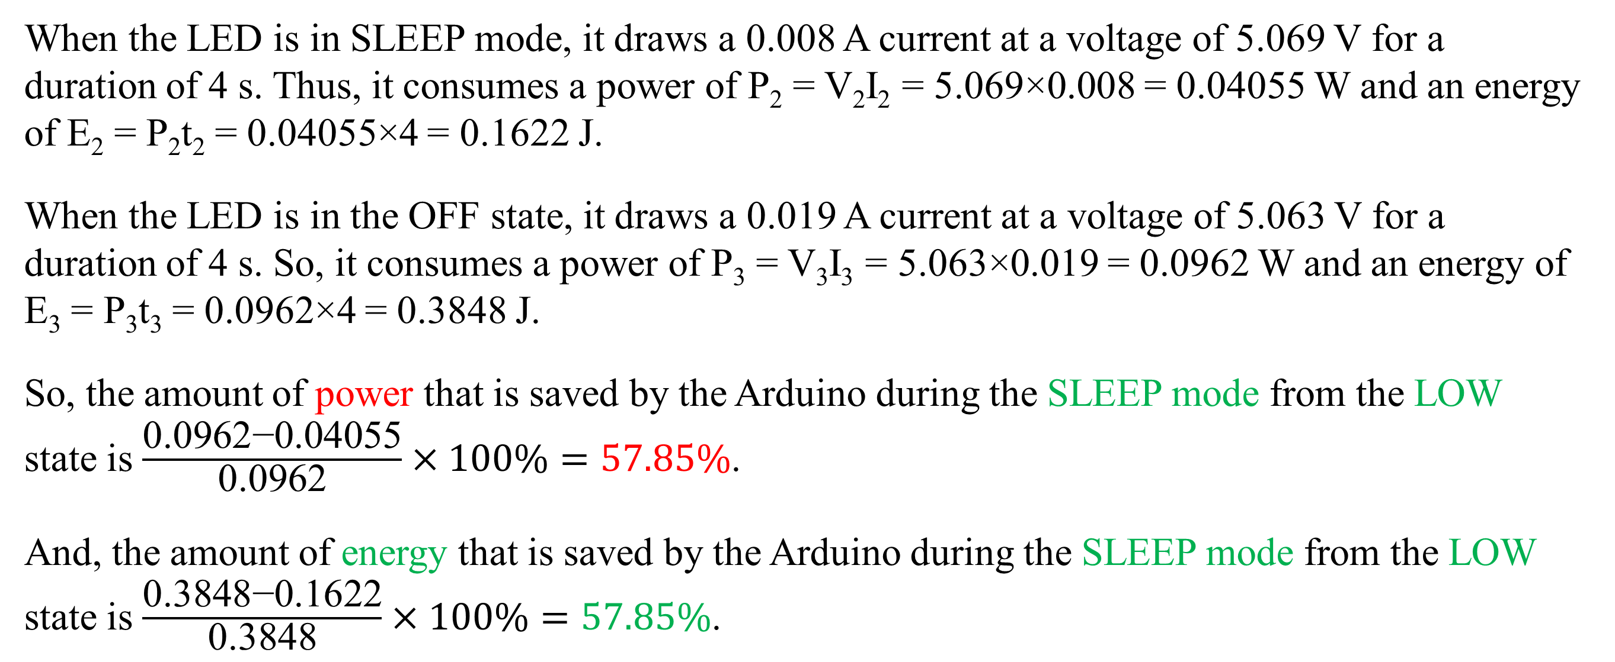
Example 4
When the LED is in SLEEP mode, it draws a 0.008 A current at a voltage of 5.069 V for a duration of 4 s. Thus, it consumes a power of P₂ = V₂I₂ = 5.069×0.008 = 0.04055 W and an energy of E₂ = P₂t₂ = 0.04055×4 = 0.1622 J.
When the LED is in the OFF state, it draws a 0.019 A current at a voltage of 5.063 V for a duration of 4 s. So, it consumes a power of P₃ = V₃I₃ = 5.063×0.019 = 0.0962 W and an energy of E₃ = P₃t₃ = 0.0962×4 = 0.3848 J.
So, the amount of power that is saved by the Arduino during the SLEEP mode from the LOW state is $\frac{\text{0.0962−0.04055}}{\text{0.0962}}×100\%=57.85\%$.
And, the amount of energy that is saved by the Arduino during the SLEEP mode from the LOW state is $\frac{\text{0.3848−0.1622}}{\text{0.3848}}×100\%=57.85\%$.

Slide 46

PRR: Power Reduction Register:
Bit 7 - PRTWI: Power Reduction TWI
Bit 6 - PRTIM2: Power Reduction Timer/Counter2
Bit 5 - PRTIM0: Power Reduction Timer/Counter0
Bit 4 - Res: Reserved bit
Bit 3 - PRTIM1: Power Reduction Timer/Counter1
Bit 2 - PRSPI: Power Reduction Serial Peripheral Interface
Bit 1 - PRUSART0: Power Reduction USART0
Bit 0 - PRADC: Power Reduction ADC
Setting up PRR using Assembly Language:
0b10101100 =0xAC
LDI R10, 0xAC;
OUT PRR, R10;
IN R10, PRR;

Slide 47
Thanks for Attending….
?
(6) Reducing Arduino's Power Consumption Part 1 – YouTube
https://www.youtube.com/watch?v=ktvUunBQQD0

